Slide 1
Trendi poučevanja računalništva in informatike v Sloveniji, Evropi in širše
Andrej Brodnik, UL FRI

Slide 2
Poskusimo s tole »igrico«
1 2 3 4 5 6 7 8 9 10
32 26 52 68 75 33 7 17 66 93

Slide 3
Računalništvo in informatika
angleščina: Computer Science
francoščina: informatique
nemščina: Informatik
italijanščina: informatica
švedščina: datavetenskap – (podatkoslovje)
ruščina: информатика
...

Slide 4
The Royal Society: Shut down or restart? The way forward for computing in UK schools. The Royal Society, januar 2012. http://royalsociety.org/uploadedFiles/Royal_Society_Content/education/policy/computing-in-schools/2012-01-12-Computing-in-Schools.pdf. (The Royal Society)
This report analyses the current state of Computing education in schools and sets out a way forward for improving on the present situation. With support from the Royal Academy of Engineering and others the Royal Society has used its ‘convening’ role to bring together a wide range of distinguished Computer Scientists and stakeholders to explore problems and propose solutions.
Paul Nurse
President of the Royal Society

Slide 5
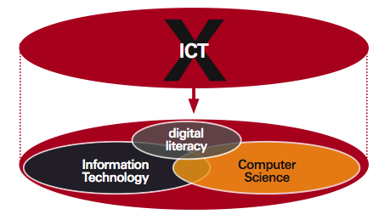
Kako izgleda RIN v šoli?
(The Royal Society).

Slide 6
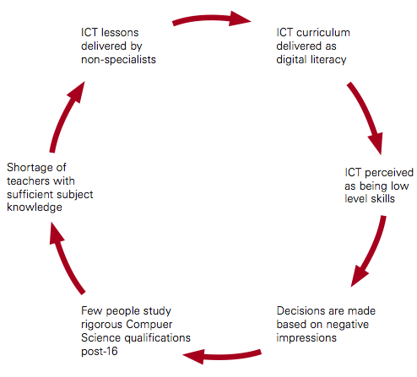
Kje je problem
Učenje računalništva in informatike naj bi razvilo mlade ljudi v razvijalce in tvorce tehnologije in ne samo uporabnike tehnologije – pristop, ki poudarja ustvarjalnost in izraznost ter ne samo produktivnosti.

Slide 7
Slovenija
Osnovna šola:
izbirni predmeti: Urejanje besedil; Računalniška omrežja; Multimedija
Srednja šola:
odvisno od vrste srednje šole: gimnazija, tehniške gimnazije, poklicne šole

Slide 8
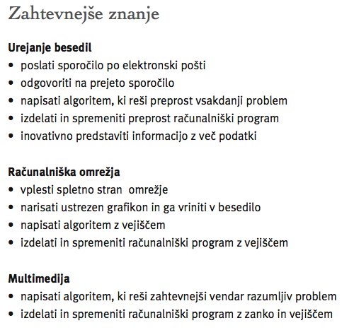
OŠ

Slide 9
Tehniška gimnazija
izbirni predmeti (70 ur je 1 ura na teden celo leto):
Računalniški sistemi in omrežja (210 ur): Arhitektura računalniških sistemov, Računalniška omrežja, Operacijski sistemi, Napredno programiranje, zaščita podatkov
Računalništvo (280 ur, maturitetni predmet): Arhitektura računalniških sistemov, Računalniška omrežja, Operacijski sistemi, Programski jeziki in programiranje, Podatkovne baze, Informacijski sistemi
Laboratorijske vaje (210 ur)

Slide 10
Splošna gimnazija
Informatika (70 ur, obvezni predmet; 210ur, izbirni predmet; 70+210ur, maturitetni predmet)
splošna znanja: Osnove informatike, Digitalna tehnologija, Predstavitev informacij
posebna znanja: Predstavitev informacij, Obdelava podatkov

Slide 11
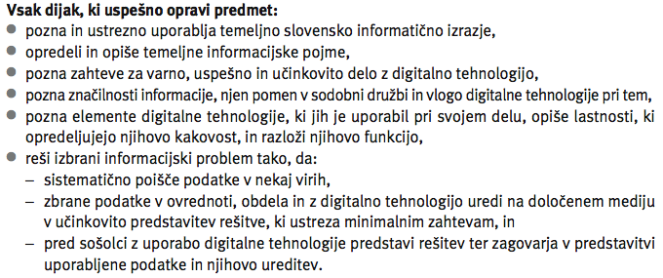
Splošna gimnazija

Slide 12
Splošna gimnazija

Slide 13
Splošna gimnazija

Slide 14
Slovenske uvrstitve na IOI
2011 – Tajska: (308 tekmovalcev, 79 držav)
medalje: 1 bronasta 79. mesto – v 1/4
po skupnem številu točk 57. država – v 3/4
po povprečju na tekmovalca 58. država – v 3/4
samo najboljši tekmovalec 39. država – v 2/4
samo najslabši tekmovalec 56. država – v ¾
Kanada, Univerza v Waterlooju: 25 zaposlenih v The Centre for Education in Mathematics and Computing, http://cscircles.cemc.uwaterloo.ca/

Slide 15
Slovenske uvrstitve na IOI (nadalj.)
1989 – Bolgarija: NP
1990 – Belorusija: NP
1991 – Grčija: NP
1992 – Nemčija: ni sodelovala
1993 – Argentina: ni podatka
1994 – Švedska: brez medalje
1995 – Nizozemska: ni podatka
1996 – Madžarska: 2 bronasti
1997 - Južna Afrika: 1 bronasta
1998 – Portugalska: 1 bronasta
1999 – Turčija: 1 bronasta
2000 – Kitajska: ni podatka
2001 – Finska: ni podatka
2002 - Južna Koreja: 1 bronasta
2003 – ZDA: 3 bronaste
2004 – Grčija: 1 bronasta
2005 – Poljska: ni podatka
2006 – Mehika: 2 bronasti
2007 – Hrvaška: 1 bronasta
2008 – Egipt: 1 bronasta
2009 – Bolgarija: brez medalje
2010 – Kanada: 1 srebrna
2011 – Tajska: 1 bronasta

Slide 16
Slovaška
 |  |  | 1 | 2 | 3 | 4 | 5 | 6 | 7 | 8 | 9 | 10 | 11 | 12 | 13
till 1985 |  |  |  |  |  |  |  |  |  |  |  | optional
1985 |  |  |  |  |  |  |  |  |  |  |  | 2 | 1
1990 |  |  |  |  |  |  |  |  |  |  |  | 1 | 1
1998 |  |  |  |  |  |  | optional |  |  |  |  | 1 | 1
2006 |  |  | optional |  |  |  | optional |  |  |  |  | 1 | 1
2008 |  |  | 3 |  |  |  | 3 |  |  |  |  | 3
Andrej Blaho, Comenius University, Slovakia
Andrej Brodnik, 120823
Trendi poučevanja RIN
15
Notes:
It can be instructive

Slide 17
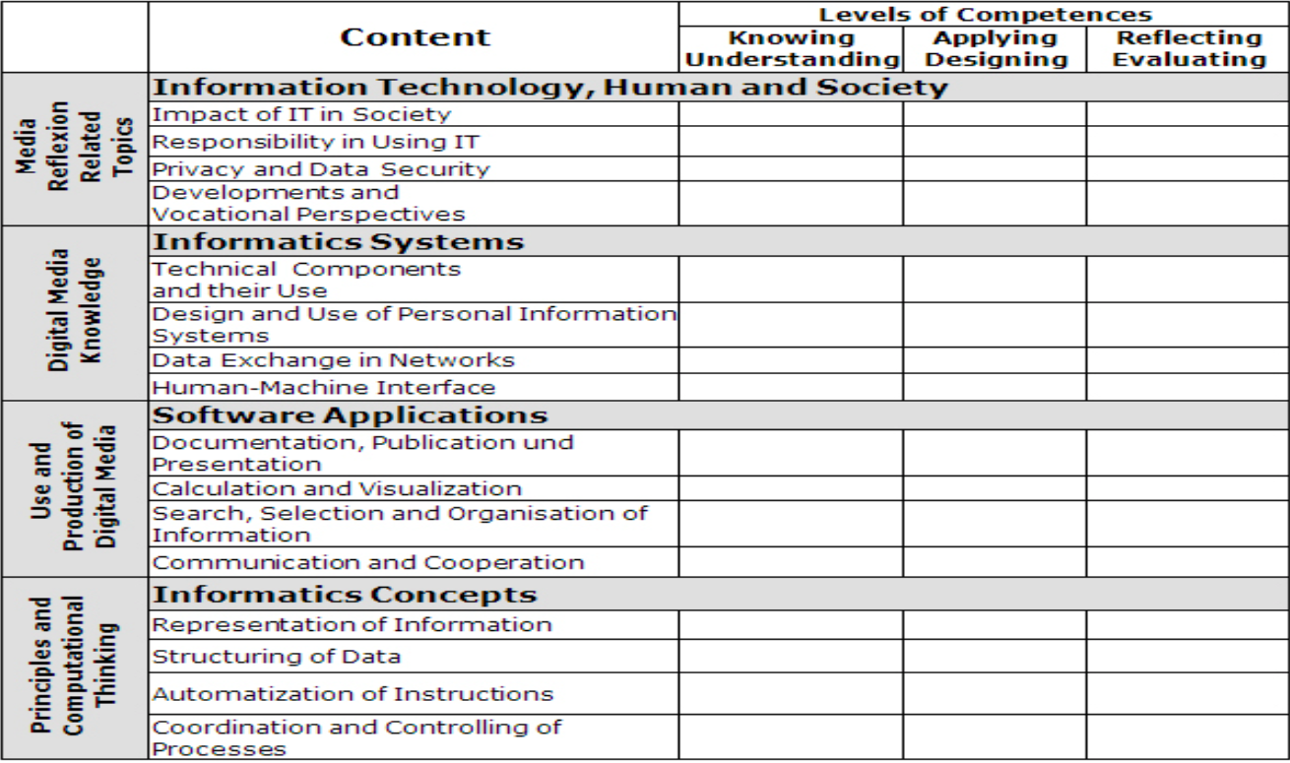
Avstrija
Peter Micheuz/Gerald Futschek: Model for Digital Competence and Basic Informatics Education in Austria’s Lower Secondary Level

Slide 18
The Educational Structure in the Republic of Lithuania (prof.dr. Valentina Dagiene)
 |  | SECONDARY SCHOOL | GYMNASIUM
age
grade
HIGHER EDUCATION
UNIVERSITIES
ADVANCED VACATIONAL
19
12
VACATIONAL SCHOOL
17
11
10
9
8
BASIC SCHOOL
11
5
4
PRIMARY SCHOOL
7
1

Slide 19
Informatics is defined as the science dealing with design, realization, evaluation, use, and maintenance of information processing systems, including hardware, software, organizational and human aspects
Computer
literacy
Informatics
Information
technologies
Information Technology is defined as the technological applications of informatics in society
ICT means the combination of IT with other, related technologies
by UNESCO
Notes:
This definition implies that ICT will be used, applied, and integrated in activities of working and learning on the basis of conceptual understanding and methods of informatics.

Slide 20
Teaching Informatics / Information Technologies (IT)
Years | Grades | Mandatory subject | Optional subject
1986-1997 | grade 10-12 | Informatics, 2 lessons/week | various IT modules
1997-2004 | basic school, grades 9-10 | Informatics, IT 2 lessons/week
 | secondary, grades 11-12 | Informatics, IT 2 lessons/week | various modules, 2-4 lessons/week
Since 2004 | grades 5-6 | IT, 2 lessons/week
 | grades 7-8 | IT, 1 lesson/week 1 lesson integrated
 | grades 9-10 | IT, 1 lessons/week | 1 lesson/week, programming module
 | grades 11-12 |  | IT, 2 lessons/week, advanced modules

Slide 21
Distribution themes and time for grades 5-6
Themes, subthemes | IT hours | Subjects, integration is addressed to, and hours
Introduction to computer application | 14
Drawing with computer | 8 | + Art; 10
Text and keyboard | 14 | + Mother tongue; 10
Internet and electronic mail | 8 | + Mother tongue; 4 + Foreign language; 10
Modelling with Logo | 24

Slide 22
Distribution themes and time for grades 7-8
Themes, subthemes | IT hours | Subjects, integration is addressed to
Information precessing | 4
Creation, editing and publishing a text document | 6 | + Mother tongue; 4
Internet and electronic mail | 4 | + Languages; 10
Elements of spreadsheats | 18 | + Mathematics; 10
Preparation and demonstartion of presentations | 2 | + All subjects; 10

Slide 23
IT curricula for grades 9-10 and 11-12
Compulsory course, 9-10 grades | Optional course, 11-12 grades | Additional modules, 11-12 grades
Computer (principles of the work) | Advanced elements of text editing | Data base
Text processing | Presentation | Multimedia
Information (basics of information handling) | WWW and electronic mail | Programming
Algorithms (main concepts and commands) | Social and ethical issues of using IT
 | Spreadsheet
Notes:
IT standards and contents of its courses are divided into the main ICT topics as it is shown in Table 1. The intended aims for the 9th-10th and the 11th-12th grades are essentially different. The IT standards for the 9th and 10th grades very precisely define the ICT knowledge and skills the students should obtain. The IT standards for the 11th and 12th grades are combined from two components. The first one describes general ability, while the second one is provided to define the particular achievements related to particular topics and chapters. General ability is rather broad and matches the common goals of the course. The content of curriculum is close to that of European Computer Driving License (ECDL), thus the main stress is placed on the substantial intelligence of ICT and on the formation of practical skills.

Slide 24
Information Technology Maturity Exams
1995-2002: Informatics Maturity Exam – Scool level
Since 2005: National Information Technologies Maturity Exam (75% on programming – Pascal)

Slide 25
Components of curriculum of programming exam
Algorithms | Data structures | Control structures
Calculation of the sums (of product, quantity, and arithmetical average). Search of the maximal (minimal) value. Data input/output. Data sorting. Ability to modify algorithms according to the particular data structures | Integer and real, char, boolean, and string Text file. One-dimension array. Record. Ability to create uncomplicated data structures. | Program structure. Commentary. Variables Assignment and sentence. Relational and logical operations, if statement Loops. Compound statement; Procedure and function. Lists of parameters and arguments. Standard mathematical procedures and functions. Procedures and functions related with files.
Programming environment. Technology of structural (procedural) programming. Testing. Program documentations. Arrangement of dialog. Program writing (style)

Slide 26
IFIP TC3 – ICT and Education
International Federation for Information Processing, deluje v okviru UNESCO
URL: http://www.ifip-tc3.net/
delovne skupine:
osnovno šolstvo (WG 3.5), srednje šolstvo (WG 3.1), visoko šolstvo (WG 3.2); vseživljensko izobraževanje (WG 3.8)
oddaljeno izobraževanje (WG 3.6)
raziskovalna dejavnost (WG 3.3)
strokovni razvoj (WG 3.4)
vodenje in upravljanje (WG 3.7)
digitalna pismenost (SIG 3.9 posebna interesna skupina)

Slide 27
IFIP TC3 Strategy Plan
To provide an international forum for educators to discuss research and practice in:
teaching informatics
educational uses of communication and information technologies (ICT)
To establish models for informatics curricula, training programs, and teaching methodologies.
To consider the relationship of informatics in other curriculum areas.
To promote the ongoing education of ICT professionals and those in the workforce whose employment involves the use of ICT.
To examine the impact of ICT on the whole educational environment:
teaching and learning
administration and management of the educational enterprise
local, national and regional policy-making and collaboration.
To engage with formal and informal learning environments, including homes, communities and the world of work, as characteristics of the knowledge society.
To support the engineering of a more equitable knowledge society.

Slide 28
Kje je problem
Učenje računalništva in informatike naj bi razvilo mlade ljudi v razvijalce in tvorce tehnologije in ne samo uporabnike tehnologije – pristop, ki poudarja ustvarjalnost in izraznost ter ne samo produktivnosti.

Slide 29
Učni načrti in nekateri viri
https://lusy.fri.uni-lj.si/redmine/projects/cs-edu
Osnovna in srednja šola:
ACM K12 kurikulum
UNESCO IFIP kurikulum
IOI Syllabus za mednarodne olimpijade iz računalništva in informatike
Zavod republike Slovenije za šolstvo
CS Teacher Association (http://csta.acm.org/ )
Koli 2011 Working group on Teaching Computing at School / Computing Teacher Education (http://cs.joensuu.fi/kolistelut/index.php/previous-koli-calling-conferences/koli-calling-2011/teaching-workshop-2011)
Čas za ponovni premislek o izobraževanju računalništva in informatike (https://lusy.fri.uni-lj.si/redmine/projects/cs-edu/wiki/%C4%8Cas_za_ponovni_premislek_o_izobra%C5%BEevanju_ra%C4%8Dunalni%C5%A1tva_in_informatike)
Univerza: ACM kurikulum

Slide 30
In naša igrica?
Računalniško razmišljanje
Computational thinking
1 2 3 4 5 6 7 8 9 10
32 26 52 68 75 33 7 17 66 93
3 2 5 7 8 4 0 1 6 9
+1
4 3 6 8 9 5 1 2 7 10
1 2 3 4 5 6 7 8 9 10
7 17 26 32 33 52 66 68 75 93
Znanje uporabe pralnega praška še ni znanje kemije.
Hvala!

